Slide 1

Leadership

Slide 2
Concept of Leadership
According to Robbins, “Leadership is the ability to influence a group toward the achievement of goals.”
According to Keith Davis, “leadership is the ability to persuade others to seek defined objectives enthusiastically.”
Leadership can be taken as a:
Process: It is used to direct, motivate and coordinate the employees
Property: It involves traits of a leader and how he uses his traits to motivate the employees
Power: Power of getting things done.

Slide 3
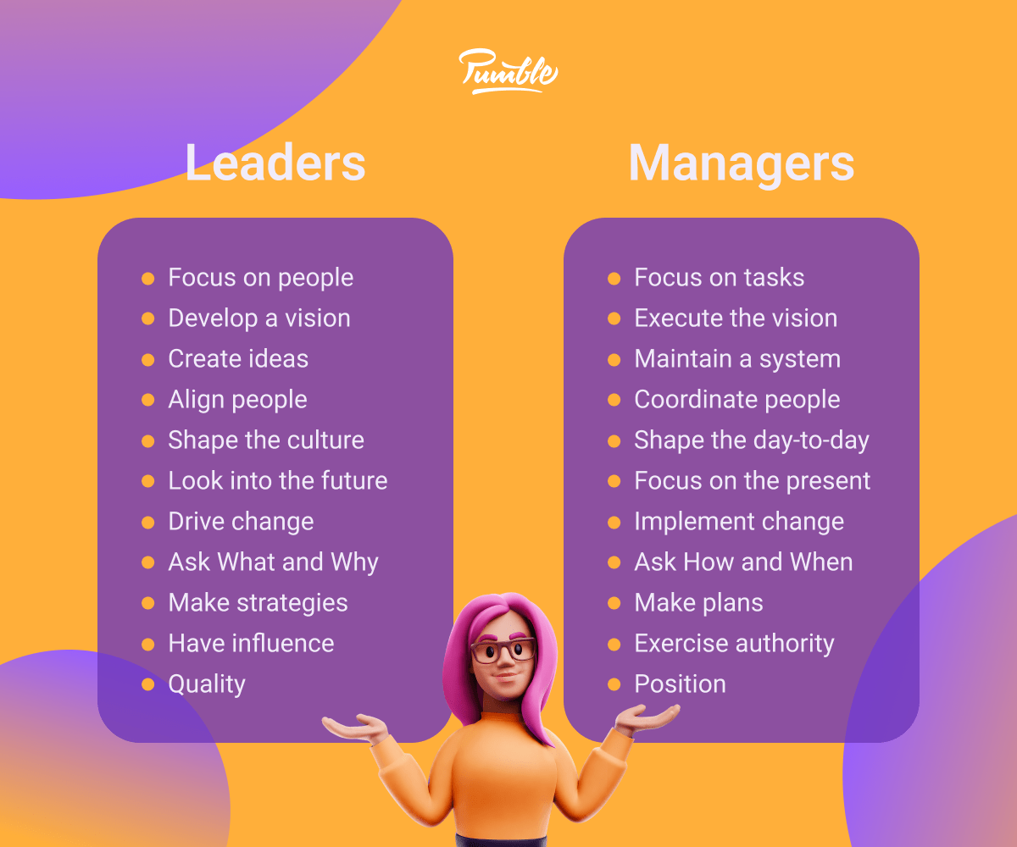

Slide 4
Trait Theory of Leadership
This theory is the first organized approach to studying leadership which analyzed the personal, psychological, and physical traits of strong leaders.
Trait theory of leadership, also known as the "great man" theory, suggests that certain individuals possess inherent traits or characteristics that make them natural leaders. These traits are believed to be relatively stable over time and across different situations.
The traits approach assumed that:
Leaders are born not made
Some basic trait or set of traits existed that differentiated leaders from non-leaders.
Traits remain unchanged over time
If those traits could be defined, potential leaders could be identified.

Slide 5
Trait Theory of Leadership
Some common traits that an effective leader should possess are:
Achievement drive
Leadership motivation
Honesty and integrity
Self confidence
Cognitive ability
Job related knowledge
Emotional maturity
Creativity and originality
Organizing ability

Slide 6
Based on latest findings, two conclusions can be listed:
Traits can predict leadership
Traits do a better job at predicting the emergence of leaders and the appearance of leaders
Limitations:
No universal traits found that predict leadership in all situations.
Unclear evidence of the cause and effect of relationship of leadership and traits.
Better predictor of the appearance of leadership than distinguishing effective and ineffective leaders.

Slide 7
Behavioral Approach to Leadership
The Ohio state studies
Behavioral theories propose that specific role behaviors differentiate leaders from non-leaders.
The specific role behavior is determined in terms of how leaders delegate their tasks, how they communicate and motivated their followers.
The fundamental assumption of behavioral theories is “Leadership behavior can be taught.” The main goal of these behavioral theories was to develop leaders.

Slide 8
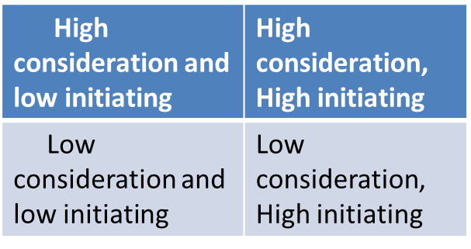
Two dimensions of leadership i.e. initiating structure and consideration.
Initiating Structure: It refers to the extent to which a leader is likely to define and structure his or her role and those of sub-ordinates (in the search for goal attainment).
Consideration: It refers to the extent to which a leader is likely to have job relationships characterized by mutual trust, respect for subordinate’s ideas, and regard for their feelings.
High
Consideration
Low
Initiating High
Structure

Slide 9
The findings of the study showed that:
Higher structure behavior resulted in higher performance of employees, but lower level of their satisfaction.
Higher consideration behavior resulted in lower performance of employees, but had fewer absences from work.
Thus, high structure and high consideration style was the best all round style as it embraces the best of both the categories.
Criticisms: Both initiating structure and consideration may or may not be used in balance way. Further only selected considerations and initiating factors are not ultimate elements to result in best leadership. It does not take into account the situational variables that affect consideration and initiating structure.

Slide 10
B. The university of Michigan Studies
The researchers at university of Michigan conducted a study to identify the behavioral characteristics of leaders that were related to performance effectiveness.
The research findings showed two basic forms of leadership behavior:
Employee-Oriented Leader Behavior: Emphasizing interpersonal relations; taking a personal interest in the needs of employees and accepting individual differences among members.
This leadership behavior shows more concern for human aspects of the group. The leaders concern here is to build effective work groups.

Slide 11
Production-Oriented Leader Behavior:
Emphasizing technical or task aspects of the job.
This leadership behavior pays close attention to the work of subordinates and is mainly interested in performance. The leaders concern’s here is efficiency and task performance.
Conclusion: Unlike other studies, the Michigan studies concluded that leaders who were employee oriented were able to get high group productivity and high group member satisfaction.
Criticism: It ignores the impact of situation on leadership behavior.

Slide 12
C. The managerial grid
Robert R Blake and Jane S Mouton, 1964 developed the two behavioral dimensions of leadership- concern for people and concern for production as used by the Ohio and the Michigan Studies.
The people centered dimension reflected the concern for people and task centered dimension reflects concern for production.
Arranging the two dimensions a leadership grid can be obtained depicting (9*9 =) 81styles of leadership as in the figure below. The scale 1 stands for minimum and 9 for maximum concern. Horizontal axis concerns for production and vertical axis concern for people.

Slide 13
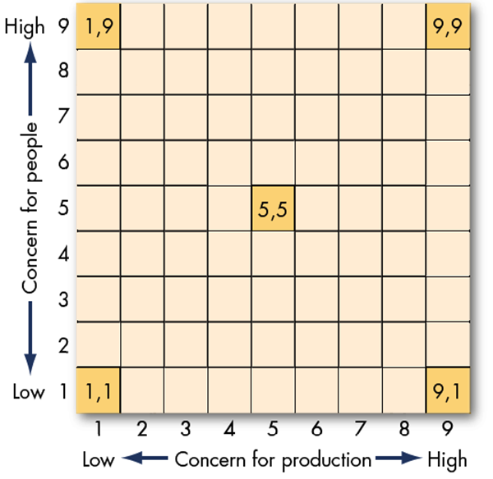
Managerial Grid
The 9, 1 style: the leaders’ shows primary concern for production. This style is also called task management or authoritarian management.
The 1, 9 style: the leader shows primary concern for people. This style is also known as country-club type of leadership.

Slide 14
The 1, 1 style: the leader has minimum concern for either people or production. This style is also called impoverished leadership or laissez-fair management.
The 5, 5 style: the leader has moderate concern for both production and people. This style is also called middle-of-the-road or compromising leadership.
The 9, 9 style: the leader shows high concern for both people and production. This is also called team-based style or democratic management. This is the most effective leadership style.
The researchers proposed that it is the best to be high on both. Managers who do not score a 9, 9 would then receive training on how to become a 9, 9 leader. Leaders are most effective when they achieve high and balanced concern for both people and task.
Today this model is criticized. It makes very simplistic assumptions about leadership style. It basically follows one best way style. The argument is that 9, 9 styles can’t be based under all circumstances.

Slide 15
Contingency Theories
This theory has assumed that appropriate leader behavior varies from one situation to another. Thus, the goal of a contingency theory is to identify important situational factors and to specify how they interact to determine appropriate leader behavior.
Since, it is based on situation it is also called situational approach. The situational characteristics that affect decision making of leaders are the type of organization, group effectiveness, the problem itself, and time pressures

Slide 16
Contingency Theories
The Fiedler Model
The first comprehensive contingency model for leadership was developed by Fred Fiedler. This model proposes that effective group performance depends on the proper match between the leader’s style of interacting with his or her subordinates and the degree to which the situation gives control and influence to the leader.
In this theory, Fielder assumes that:
Leadership style is fixed, that is either task oriented or relationship oriented
Leader-member relations, task structure, and position power are the key variables that determine situational favorableness for a leader

Slide 17
Contingency Theories
The three situational factors identified are:
leader-member relations(the degree of confidence, trust, and respect subordinates have in or for their leader),
task structure ( the degree to which the job assignments of subordinates are structured) and
position power (the degree of influence a leader has over power variables such as hiring, firing, discipline, promotion etc.)
It was found that when the situation was favorable for the leader, task oriented leadership style was found to be giving positive outcomes, similarly even when the situation was unfavorable, the task oriented leadership style was found to give positive results. However, when the situation was moderately favorable the people oriented leadership style was found to be giving positive outcomes.

Slide 18
Contingency Theories
Path Goal theory
Path-goal theory is developed by Robert House, path –goal theory is a contingency model of leadership. This theory provides a way of diagnosing the leadership style needed in very complex organizational situations. According to this theory, leaders attempt to influence their employees’ perceptions of payoffs for accomplishing their goals and show them ways to achieve the goals.
Premise
Leader must help followers attaining goals and reduce roadblocks to success
Leaders must change behaviors to fit the situation (environmental contingencies & subordinate contingencies)
The path-goal theory of leadership suggests that the primary functions of a leader are to make valued or desired rewards available in the workplace and to clarify for the subordinate the kinds of behavior that will lead to goal accomplishment and valued rewards- that is, the leader should clarify the paths to goal attainment. So, leader plays a role of path shower in this theory.

Slide 19
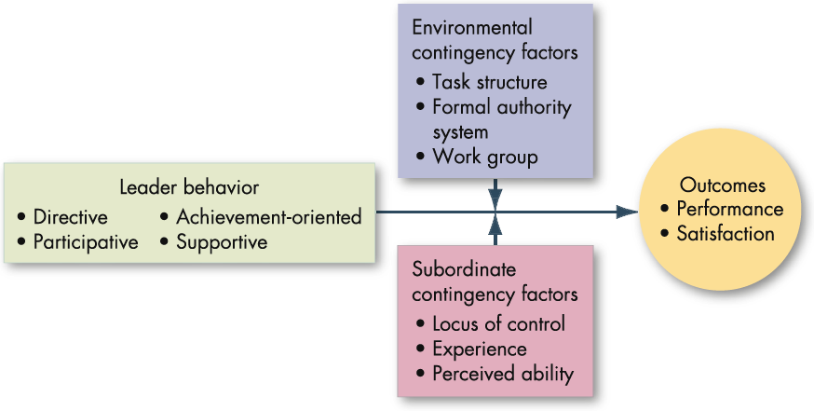
Contingency Theories

Slide 20
Contingency Theories
The leader chooses among four styles
Directive: The leader tells employees what s/he expects of them, gives them guidance about what they should do, and shows them how to do it. This dimension closely parallels the Ohio State studies’ initiating structure.
Supportive: The leader shows concern for the well-being and needs of his/her employees by being friendly and approachable. This dimension is essentially synonymous with Ohio State studies’ consideration.
Participative: The leader involves employees in decision making, consults with them about their views of the situation, asks for their suggestions, considers those suggestions in making a decision, and sometimes lets the employees make the decisions.
Achievement-oriented: The leader helps employees set challenging goals, rewards the accomplishment of these goals, and encourages employees to assume responsibility for achieving the goals.

Slide 21
Emerging approaches to leadership
1. Transactional Leadership
Transactional leaders focus on structure, order, and rewards to maintain performance and efficiency.
Key Characteristics:
✅ Task-Oriented – Leaders ensure employees follow rules and complete assigned tasks. ✅ Rewards & Punishments – Performance is managed through incentives (rewards for success, punishments for failure). ✅ Clear Expectations – Employees know what is expected of them through formal processes. ✅ Short-Term Focus – Focuses on maintaining stability and efficiency rather than long-term innovation. ✅ Top-Down Approach – Decision-making is centralized, with little room for employee input.

Slide 22
Emerging approaches to leadership
Advantages:
✔️ Ensures discipline and order.
✔️ Efficient in structured environments (e.g., military, large corporations).
✔️ Clear roles and responsibilities lead to productivity.
Disadvantages:
❌ Can limit creativity and innovation. ❌ Employees may feel micromanaged. ❌ Less effective in dynamic or rapidly changing environments.

Slide 23
Emerging approaches to leadership
2. Transformational Leadership
Transformational leaders inspire and motivate employees to exceed expectations and foster innovation.
Key Characteristics:
✅ Visionary & Inspirational – Leaders communicate a strong vision and encourage enthusiasm. ✅ Encourages Innovation – Employees are empowered to be creative and take initiative. ✅ Focus on Growth – Leadership is based on personal development and motivation. ✅ Emphasizes Change – Leaders challenge the status quo and adapt to dynamic environments. ✅ High Emotional Intelligence – Builds trust, strong relationships, and a positive work culture.

Slide 24
Emerging approaches to leadership
Advantages:
✔️ Boosts employee engagement and job satisfaction.
✔️ Encourages creativity and innovation.
✔️ Adaptable in fast-changing industries (e.g., technology, startups).
Disadvantages:
❌ Requires strong communication and emotional intelligence. ❌ May not be suitable for rigid or highly structured organizations. ❌ Can be risky if the vision is unrealistic or poorly implemented.

Slide 25
Key Differences at a Glance:
Feature | Transactional Leadership | Transformational Leadership
Focus | Task completion & efficiency | Innovation & motivation
Motivation | Rewards & punishments | Inspiration & empowerment
Decision-Making | Centralized, top-down | Shared, participatory
Change Approach | Maintains stability | Embraces change
Employee Engagement | Low to moderate | High
Best For | Routine tasks, predictable environments | Dynamic industries, growth-focused teams

Slide 26
Emerging approaches to leadership
3. Charismatic Leadership
Charismatic leadership is a style where leaders inspire and influence others through their personal charm, confidence, and strong vision. They create emotional connections with their followers, making people highly motivated and loyal.
Key Characteristics of Charismatic Leaders:
✅ Strong Communication Skills – They can persuade and inspire people easily. ✅ Confidence & Presence – They project self-assurance and authority. ✅ Emotional Connection – They build strong relationships with followers. ✅ Visionary Thinking – They have a clear and ambitious vision for the future. ✅ Inspiring & Motivating – They make people believe in a cause or mission.

Slide 27
Contemporary issues in Leadership
1. Ethical Leadership & Integrity
Leaders today face increased scrutiny regarding ethical behavior. Scandals and corporate fraud have made trust and transparency essential.
Issues like corruption, workplace harassment, and financial misconduct require leaders to set ethical standards.
2. Diversity, Equity, and Inclusion (DEI)
Organizations are expected to embrace diversity in terms of gender, race, culture, and perspectives.
Leaders must create inclusive environments, prevent discrimination, and ensure equal opportunities for all employees.
3. Technological Disruptions & Digital Transformation
Advancements in AI, automation, and remote work have changed how organizations operate.
Leaders need to adapt to digital tools, manage remote teams, and handle cybersecurity concerns.

Slide 28
4. Workplace Culture & Employee Well-being
The modern workforce demands better work-life balance, mental health support, and flexibility (such as remote or hybrid work models).
Leaders must create policies that prevent burnout and increase employee engagement.
5. Globalization & Cross-Cultural Leadership
With businesses operating across borders, leaders must understand cultural differences, legal regulations, and international market dynamics.
Navigating trade policies, supply chain disruptions, and political instability requires strong global leadership.
6. Crisis Leadership & Resilience
The COVID-19 pandemic showed the importance of crisis management.
Leaders must be prepared for economic downturns, public health crises, or environmental disasters while maintaining organizational stability.

Slide 29
7. Sustainability & Corporate Social Responsibility (CSR)
Environmental concerns, climate change, and sustainable business practices are now leadership priorities.
Organizations are expected to reduce carbon footprints and adopt sustainable policies.
8. Innovation & Change Management
Rapid changes in market trends require leaders to foster innovation and adaptability.
Resistance to change within organizations can be a major challenge.
9. Power Dynamics & Employee Empowerment
Traditional hierarchical leadership is being replaced by collaborative and servant leadership styles.
Employees seek more autonomy and participation in decision-making.

